Slide 1

Find the perfect student freelancer to get your job done

Slide 2


Problem
For both clients and college customers
$
Time
Money
Ability
Notes:
Problem exists for client, at the same time, students want work. Bringing them together so that they each solve the other’s problem (segue to solution slide)

Slide 3
Solution
A marketplace for small businesses to connect with student freelancers to bring their ideas to reality

Slide 4

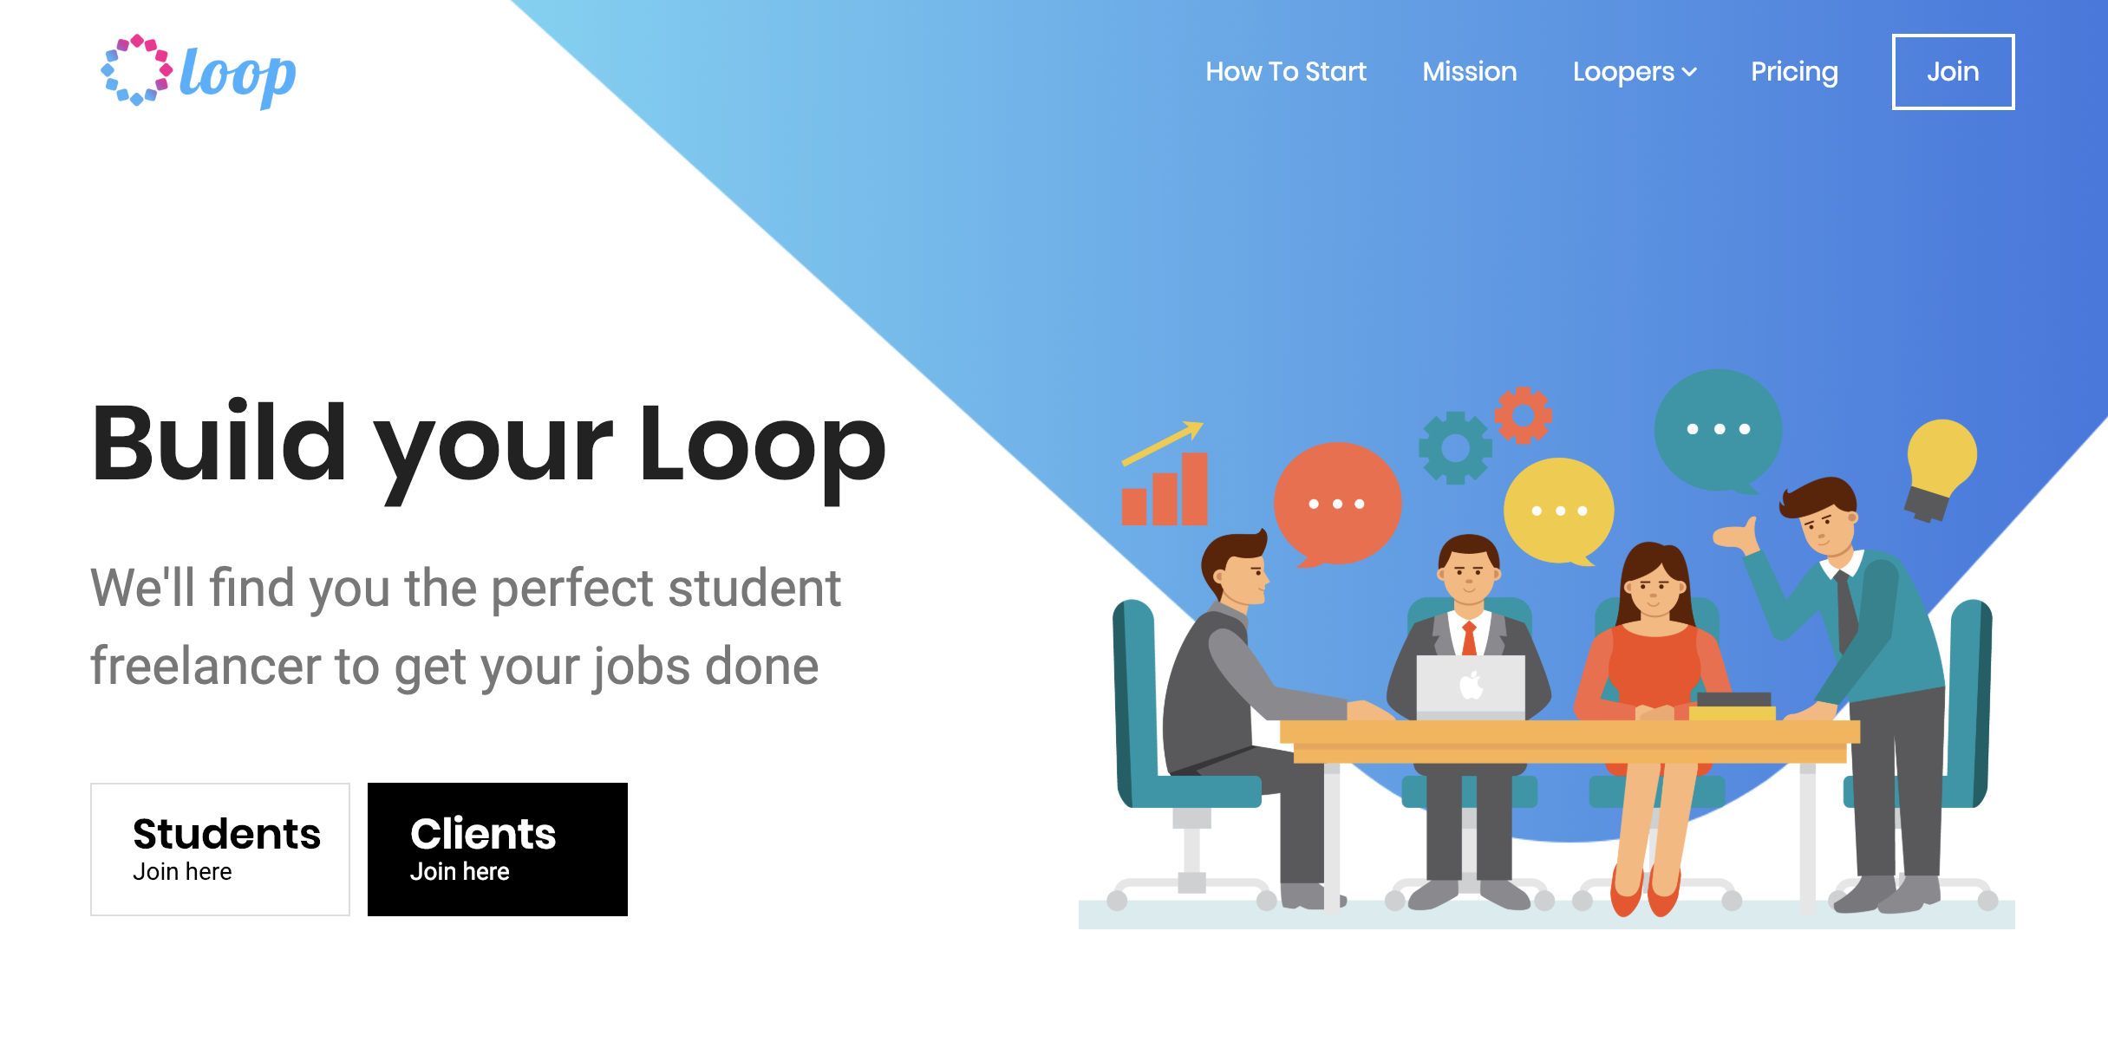
The Product

Slide 5
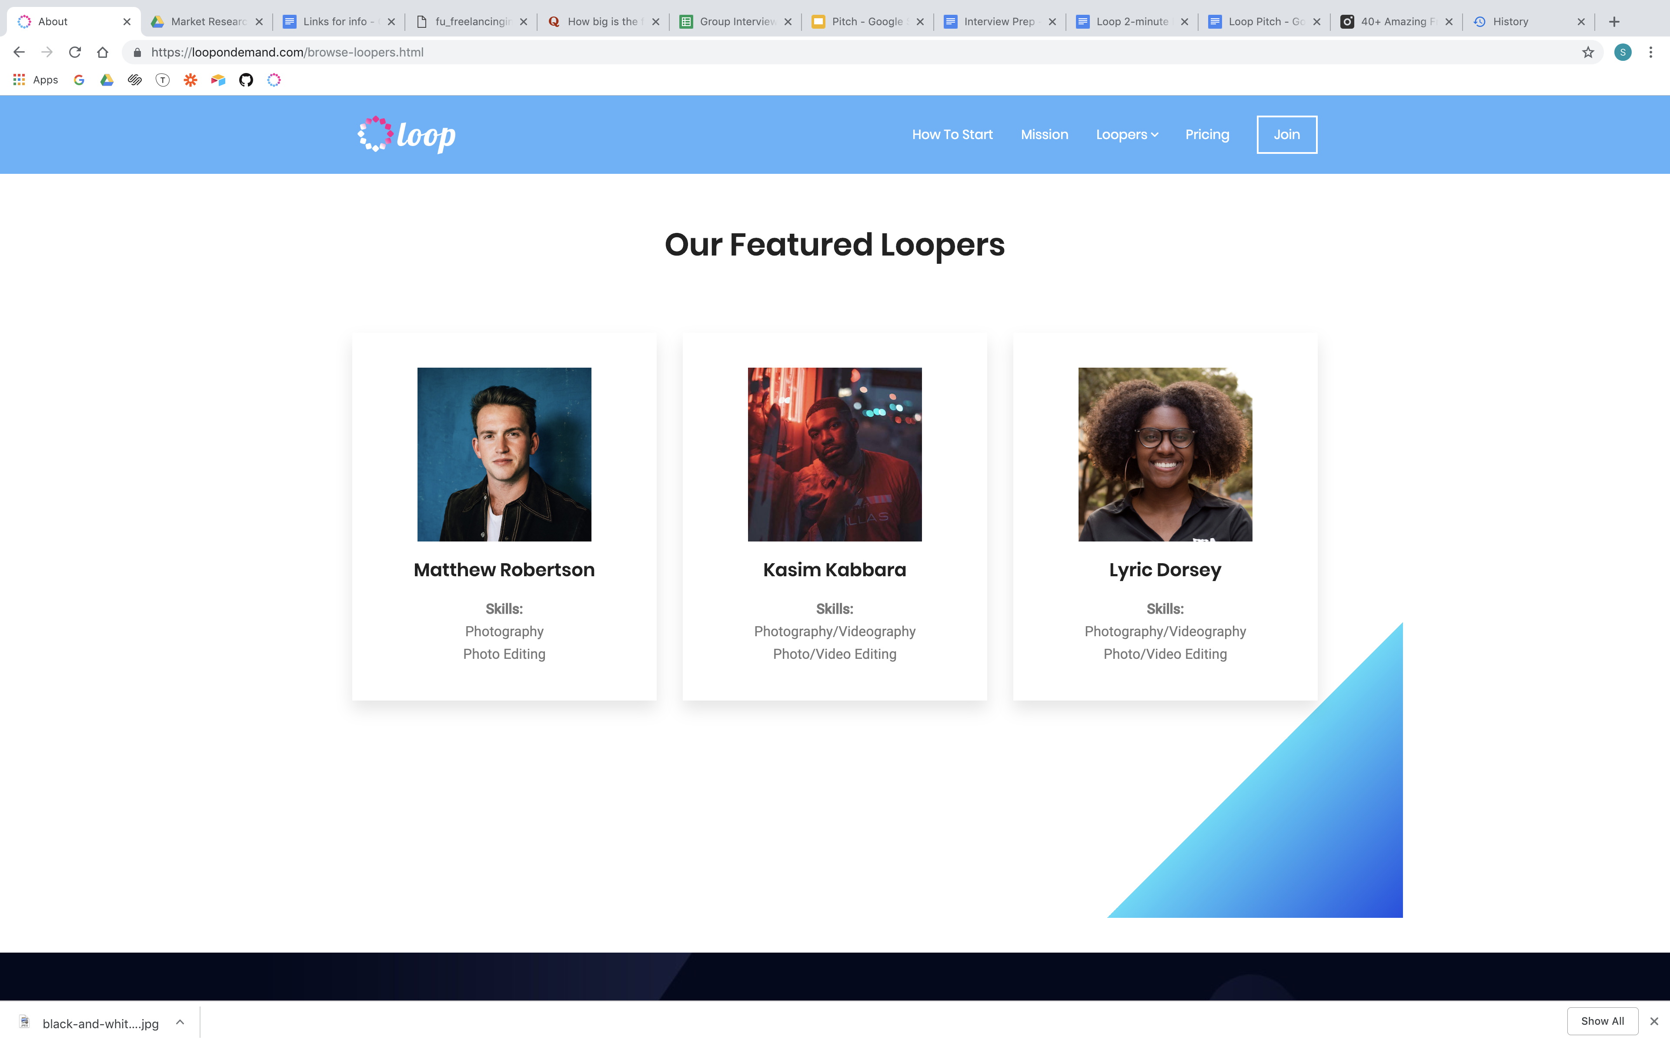
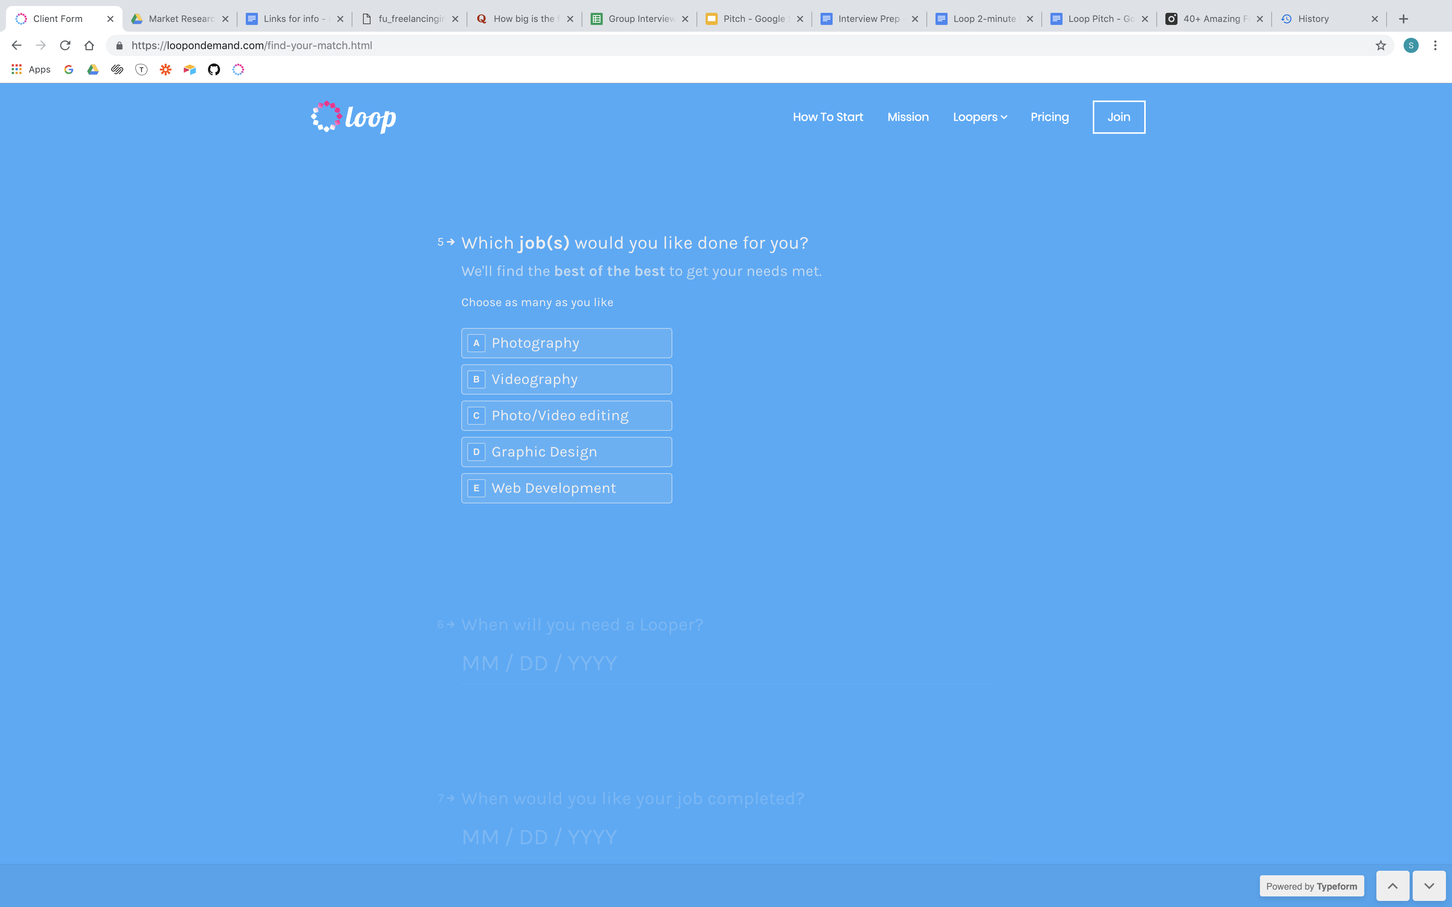
Browse or Find Your Match

Slide 6
Market Validation
freelancer.com
fiverr.com
31+ million
5+ million
registered users
registered users
16+ million
2+ million
projects posted
projects posted

Slide 7
Market Validation
freelancer.com
fiverr.com
31+ million
5+ million
registered users
registered users
16+ million
2+ million
projects posted
projects posted

Slide 8
Market Potential
50
Million freelancers in the US
% of workforce by 2027
% of millennials are freelancers

Slide 9

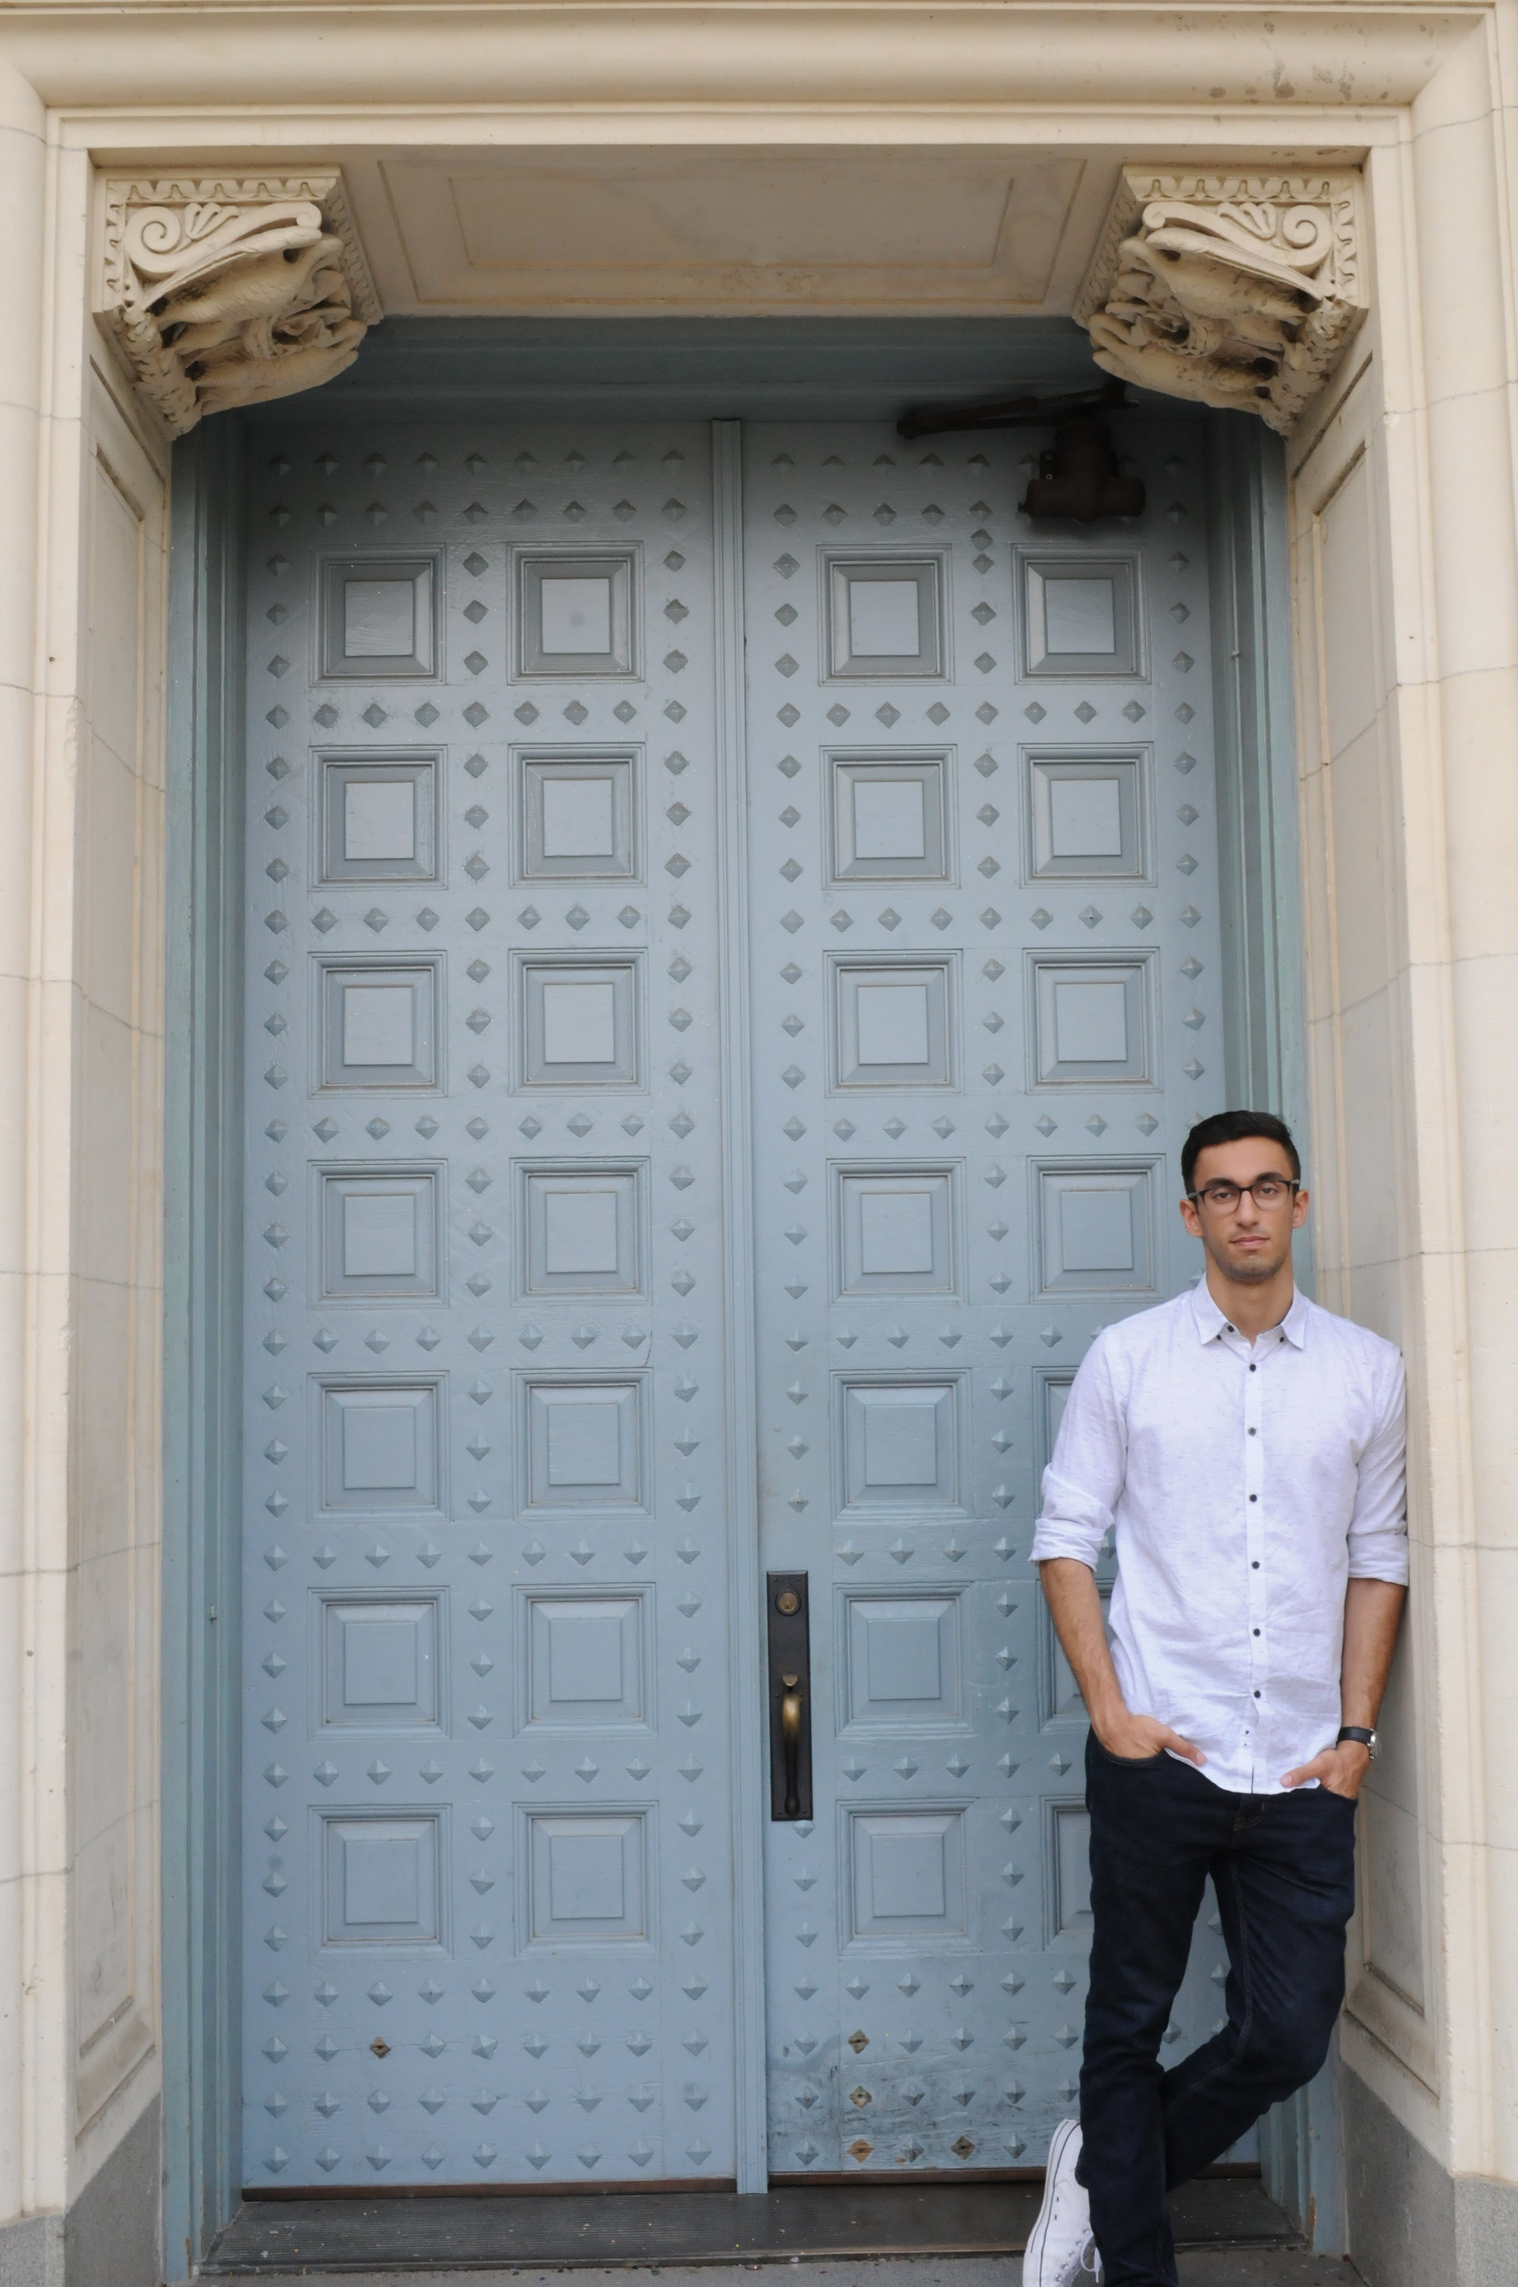
The Team
Nia Daughtry
Shawheen Attar
Founder & CEO
Co-founder & CTO

Slide 10
Problem
College Students
Clients
Time
Finding jobs
Actualize an idea
Money
Making money
Low costs
Ability
Build a portfolio
Doing the work
Notes:
Problem exists for client, at the same time, students want work. Bringing them together so that they each solve the other’s problem (segue to solution slide)

Slide 11
Market Size
$1.4 trillion
20 million
50,000
Added to economy/year by freelancers
College students in the US
Students at UT
Total Available Market
Serviceable Available Market
Initial Market

Slide 12


Problem
High prices for hiring professional freelancers
Small businesses and influencers want to build relationships with creators
College students lack a medium to capitalize on their creative skills
Notes:
Problem exists for client, at the same time, students want work. Bringing them together so that they each solve the other’s problem (segue to solution slide)

